Slide 1

DATA VISUALIZATION WITH COVID DATASET
A PROJECT REPORT
Submitted by,
AIYAAN HASAN - 20201ISE0092 ABU SUFIYAN- 20191ISE9002
TUSHAR TIWARI - 20201ISE0091
Under the guidance of,
Ms. POORNIMA S
in partial fulfillment for the award of the degree of
BACHELOR OF TECHNOLOGY
IN
INFORMATION SCIENCE AND ENGINEERING
At
PRESIDENCY UNIVERSITY BENGALURU
JANUARY 2024

Slide 2
TABLE OF CONTENTS
CHAPTER NO.
TITLE
PAGE NO.
1 ABSTRACT 1
.
2 INTRODUCTION 2-3
3 METHODOLOGY 4-5
4 RESULT 6-12
5 CONCLUSION 13-14
8

Slide 3
ABSTRACT
The COVID-19 pandemic, caused by the novel coronavirus SARS-CoV-2, has emerged as one of the most significant global crises in recent history, profoundly impacting public health, economies, and societies worldwide. As the pandemic continues to unfold, there is an urgent need for comprehensive analysis and visualization of its spread and effects to inform decision-making and response efforts.
In this project, we present a thorough examination of the COVID-19 pandemic using extensive data sourced from the Johns Hopkins University Center for Systems Science and Engineering (JHU CSSE). Our analysis employs sophisticated data visualization techniques to provide deep insights into various aspects of the pandemic, spanning epidemiological trends, geographical distribution, and temporal dynamics.
At the outset, we offer a comprehensive snapshot of the current state of the pandemic on a global scale, elucidating the total number of confirmed cases, deaths, and recoveries. By calculating key epidemiological metrics such as mortality rate and infection rate, we provide a nuanced understanding of the severity and transmissibility of the virus across different regions.
To gain insights into the spatial spread of COVID-19, we leverage geospatial visualizations to map the distribution of cases and fatalities across countries. By visually depicting hotspots and patterns of transmission, these visualizations highlight disparities in the impact of the pandemic and underscore the importance of targeted interventions and resource allocation.'
Moreover, we conduct in-depth analyses of the top 10 worst-hit countries, examining the factors contributing to their disproportionate burden of cases and deaths. Through dynamic visualizations such as bar chart races, we track the evolution of COVID-19 cases and deaths over time, providing a compelling narrative of the pandemic's trajectory and the effectiveness of containment measures.
Additionally, we explore the temporal dynamics of COVID-19 through time-series analysis, identifying trends and patterns in case counts, mortality rates, and recovery rates. By visualizing these trends over time, we offer valuable insights into the effectiveness of public health interventions and the emergence of new challenges and opportunities in the fight against the pandemic.
Overall, our project contributes to a deeper understanding of the COVID-19 pandemic by leveraging data visualization techniques to synthesize complex information into accessible and actionable insights. By shedding light on the multifaceted dimensions of the pandemic, we aim to support informed decision-making, resource allocation, and policy development efforts to mitigate its impact and safeguard public health and well-being.
1

Slide 4
DATA VISUALIZATION WITH COVID DATASET
CHAPTER-1
INTRODUCTION
The COVID-19 pandemic, caused by the novel coronavirus SARS-CoV-2, has sparked a global crisis of unprecedented proportions, profoundly affecting public health, economies, and societies worldwide. Since its emergence in late 2019, the virus has rapidly spread across continents, leading to millions of confirmed cases and significant loss of life. The pandemic has strained healthcare systems, disrupted supply chains, and triggered widespread social and economic upheaval, underscoring the urgent need for comprehensive analysis and response strategies to mitigate its impact.
In response to the pandemic, governments, public health agencies, and researchers have mobilized to collect and analyze data on COVID-19 cases, deaths, and recoveries. One of the most widely used sources of data is the repository maintained by the Johns Hopkins University Center for Systems Science and Engineering (JHU CSSE), which provides up-to- date information on the global spread of the virus. Leveraging this wealth of data, researchers have employed advanced data visualization techniques to glean insights into the epidemiological characteristics, spatial distribution, and temporal evolution of the pandemic. In this context, our project aims to contribute to the ongoing efforts to understand and address the COVID-19 pandemic through a comprehensive analysis and visualization of key trends and patterns. By harnessing the power of data visualization, we seek to provide a nuanced understanding of the pandemic's dynamics, enabling policymakers, healthcare professionals, and the general public to make informed decisions and implement effective response strategies.
2
School of Computer Science Engineering & Information Science, Presidency University.

Slide 5
DATA VISUALIZATION WITH COVID DATASET
In this work, we present a detailed exploration of the COVID-19 pandemic using data sourced from the JHU CSSE repository. We employ a range of data visualization techniques to examine various aspects of the pandemic, including its global spread, regional disparities, and temporal trends. Our analysis encompasses the following key components:
Current State of the Pandemic: We provide an overview of the current state of the pandemic globally, highlighting the total number of confirmed cases, deaths, and recoveries. By calculating key epidemiological metrics such as mortality rate and infection rate, we offer insights into the severity and transmissibility of the virus.
Geospatial Distribution: We utilize geospatial visualizations to map the distribution of COVID-19 cases and fatalities across countries, identifying hotspots and patterns of transmission. These visualizations enable us to discern regional disparities in the impact of the pandemic and inform targeted response efforts.
Temporal Dynamics: We conduct time-series analysis of COVID-19 cases and deaths, tracking their evolution over time and identifying trends and patterns. Through dynamic visualizations such as bar chart races, we provide a compelling narrative of the pandemic's trajectory and the effectiveness of containment measures.
By synthesizing complex data into accessible and actionable insights, our project aims to contribute to a deeper understanding of the COVID-19 pandemic and support evidence-based decision-making and response efforts. Through collaboration and knowledge sharing, we can collectively navigate these unprecedented challenges and emerge stronger and more resilient in the face of future pandemics.
3
School of Computer Science Engineering & Information Science, Presidency University.

Slide 6
DATA VISUALIZATION WITH COVID DATASET
CHAPTER-2
METHODOLOGY
Our methodology involves a systematic approach to data collection, preprocessing, analysis, and visualization to gain insights into various aspects of the COVID-19 pandemic. We outline the key steps below:
Data Collection: We gather data from reliable sources, primarily the Johns Hopkins University Center for Systems Science and Engineering (JHU CSSE) repository. This repository provides comprehensive datasets on COVID-19 cases, deaths, and recoveries worldwide, updated on a daily basis. Additionally, we may incorporate data from other reputable sources to supplement our analysis.
Data Preprocessing: Before conducting analysis, we preprocess the raw data to ensure consistency, accuracy, and usability. This involves tasks such as handling missing values, standardizing data formats, and aggregating data at appropriate levels (e.g., country-level or regional-level). We also perform data cleaning and validation to identify and correct any anomalies or discrepancies in the dataset.
Exploratory Data Analysis (EDA): We conduct exploratory data analysis to gain an initial understanding of the dataset and identify potential trends, patterns, and outliers. This involves descriptive statistics, data visualization, and hypothesis testing to uncover insights and formulate research questions for further analysis.
Descriptive Analysis: We perform descriptive analysis to summarize the key characteristics of the COVID-19 pandemic, including total cases, deaths, and recoveries globally and by region. This helps provide context and a baseline understanding of the pandemic's impact.
4
School of Computer Science Engineering & Information Science, Presidency University.

Slide 7
DATA VISUALIZATION WITH COVID DATASET
Spatial Analysis: We leverage geospatial analysis techniques to visualize the spatial distribution of COVID-19 cases and fatalities across countries and regions. This includes choropleth maps, heatmaps, and other geospatial visualizations to identify hotspots, clusters, and patterns of transmission.
Temporal Analysis: We conduct time-series analysis to examine the temporal dynamics of COVID-19 cases and deaths over time. This involves visualizing trends, fluctuations, and seasonality in the data using line charts, bar charts, and other time-series visualizations. We may also apply statistical techniques such as moving averages and exponential smoothing to smooth the data and identify underlying trends.
Comparative Analysis: We perform comparative analysis to compare the progression of the pandemic across different countries, regions, and demographic groups. This involves calculating metrics such as mortality rate, infection rate, and case fatality rate to assess the severity and impact of the pandemic in different contexts.
Advanced Visualization Techniques: We utilize advanced data visualization techniques such as bar chart races, treemaps, and word clouds to create dynamic and interactive visualizations of the COVID-19 data. These visualizations help communicate complex information in a clear and engaging manner, facilitating better understanding and interpretation of the data.
Statistical Modeling (if applicable): Depending on the research questions and objectives, we may employ statistical modeling techniques such as regression analysis, time-series forecasting, or machine learning algorithms to identify underlying patterns, make predictions, or test hypotheses related to the pandemic.
Interpretation and Reporting: Finally, we interpret the findings from our analysis and summarize them in a comprehensive report or presentation. We communicate key insights, trends, and implications to stakeholders, policymakers, and the general public to inform decision-making and response efforts.
By following this methodology, we aim to provide a rigorous and comprehensive analysis of the COVID-19 pandemic, leveraging data-driven insights to support evidence-based decision-making and response strategies.
5
School of Computer Science Engineering & Information Science, Presidency University.

Slide 8
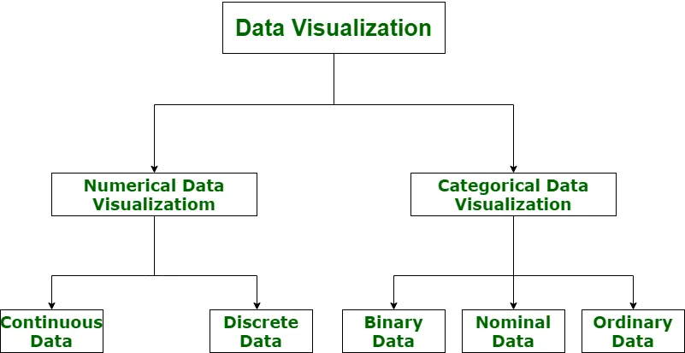
This diagram shows us the what data visualization deals with . It majorily deals with numerical and categorical data .The diagram further divides numerical data visualization into continuous and discrete data visualization . Continuous data can take on any value within a range, while discrete data can only take on specific values . For instance, weight is an example of continuous data, whereas shoe size is an example of discrete data .
Categorical data visualization is divided into binary, nominal, and ordinal data visualization . Binary data has only two categories, such as yes/no or true/false . Nominal data has multiple categories that are not ordered or ranked, like hair color or blood type . Ordinal data has multiple categories with a specific order, like customer satisfaction ratings (e.g., excellent, good, fair, poor) .
5
School of Computer Science Engineering & Information Science, Presidency University.

Slide 9
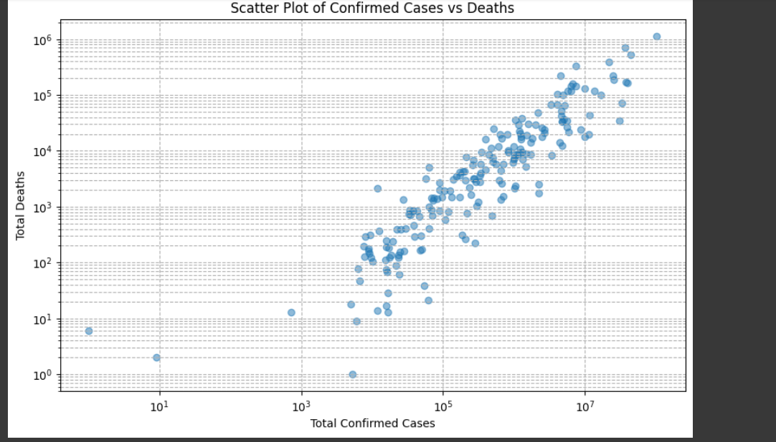
DATA VISUALIZATION WITH COVID DATASET
CHAPTER-3
RESULTS
The diagram you sent shows a scatter plot of confirmed COVID-19 cases versus deaths . Scatter plots are used to visualize the relationship between two variables . In this case, each dot represents a country or region. The horizontal position of the dot shows the total confirmed cases and the vertical position shows the total deaths.
6
School of Computer Science Engineering & Information Science, Presidency University.

Slide 10
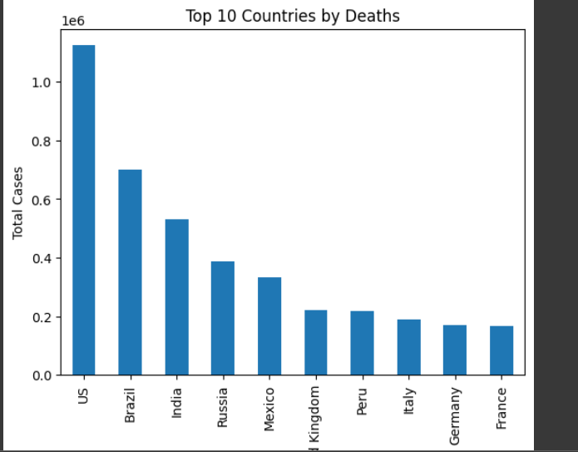
DATA VISUALIZATION WITH COVID DATASET
CHAPTER-3
RESULTS
The x-axis of the graph likely represents the total number of confirmed cases, while the y-axis shows the countries. Each bar on the graph likely represents the total number of confirmed cases for a particular country.By this graph we are getting to know that usa and brazil were the top two countries which were majorily effected by the coivd wave
7
School of Computer Science Engineering & Information Science, Presidency University.

Slide 11
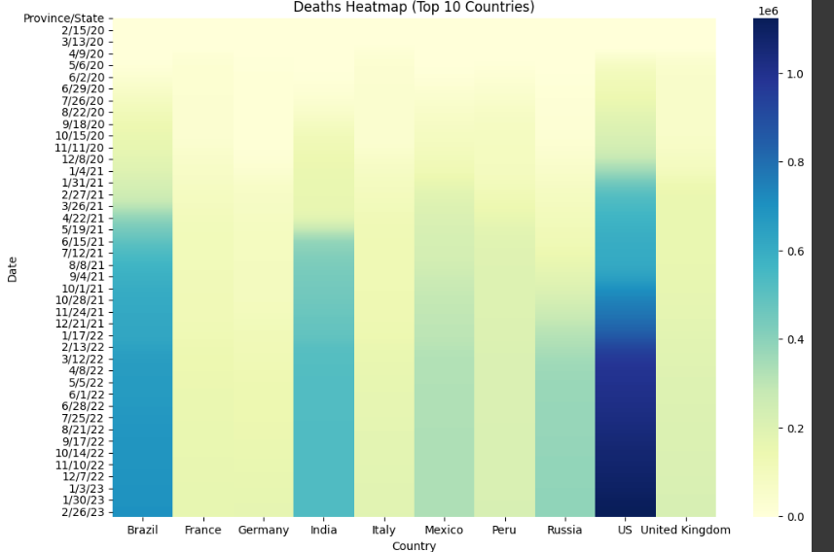
DATA VISUALIZATION WITH COVID DATASET
CHAPTER-3
RESULTS
The x-axis likely represents dates, while the y-axis shows the countries. Each cell within the heatmap uses color to represent the number of deaths on a specific date in a particular country. Here's a breakdown of what the colors might represent:
Darker colors likely represent a higher number of deaths on that date in that country.
Lighter colors likely represent a lower number of deaths on that date in that country.
.
7
School of Computer Science Engineering & Information Science, Presidency University.
8

Slide 12
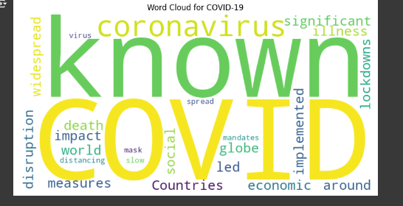
DATA VISUALIZATION WITH COVID DATASET
CHAPTER-3
RESULTS
A word cloud, also known as a tag cloud, is a visual representation of text data where the size of each word indicates its frequency or importance. If you're using a COVID-19 dataset, a word cloud can help you quickly identify the most common words or phrases in the dataset. So we have created a variable and stored enormous of words .
9
School of Computer Science Engineering & Information Science, Presidency University.

Slide 13
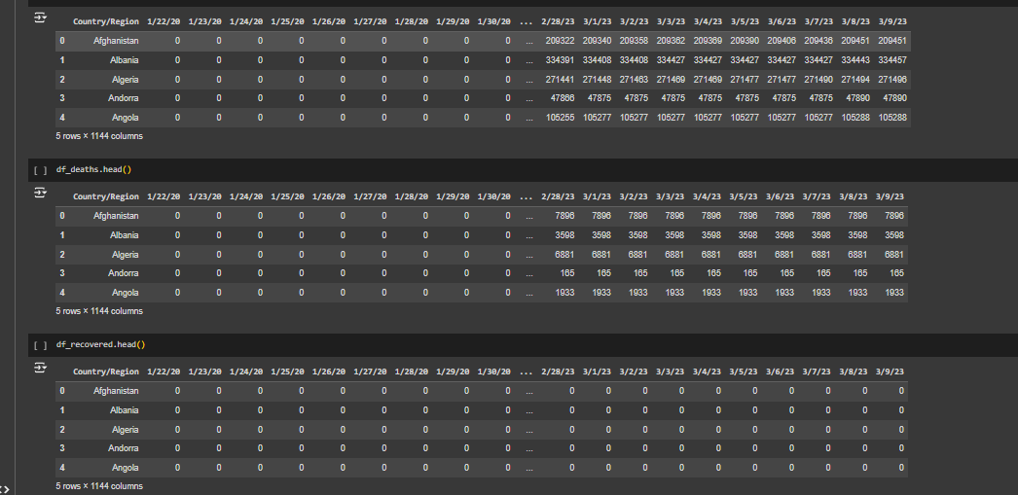
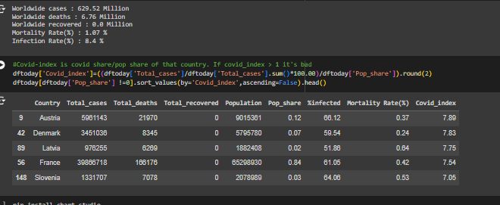
DATA VISUALIZATION WITH COVID DATASET
CHAPTER-3
RESULTS
10
School of Computer Science Engineering & Information Science, Presidency University.

Slide 14
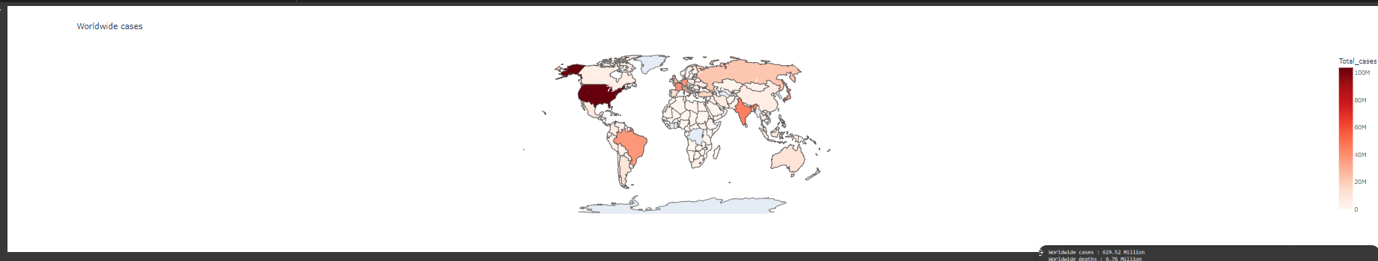
DATA VISUALIZATION WITH COVID DATASET
CHAPTER-3
RESULTS
Geospatial data refers to information linked to specific locations on Earth (or even other planets!). It combines two key elements:
Location: This is usually indicated by coordinates (latitude and longitude) but can also be broader regions.
Data: This can be anything with a geographic context, like weather patterns, population density, or COVID-19 cases.
11
School of Computer Science Engineering & Information Science, Presidency University.

Slide 15
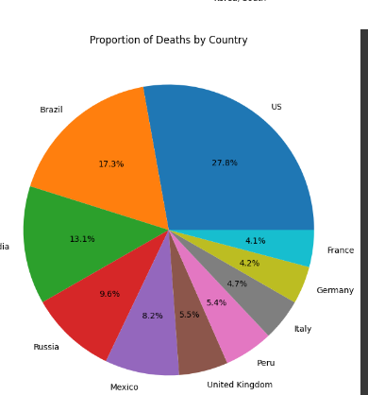
DATA VISUALIZATION WITH COVID DATASET
CHAPTER-3
RESULTS
This is the another type of data visualization type where the data the is represented in the pie chart
where we can see here the data is split in percentage format . Usa saw major rise in the second wave of covid
12
School of Computer Science Engineering & Information Science, Presidency University.

Slide 16
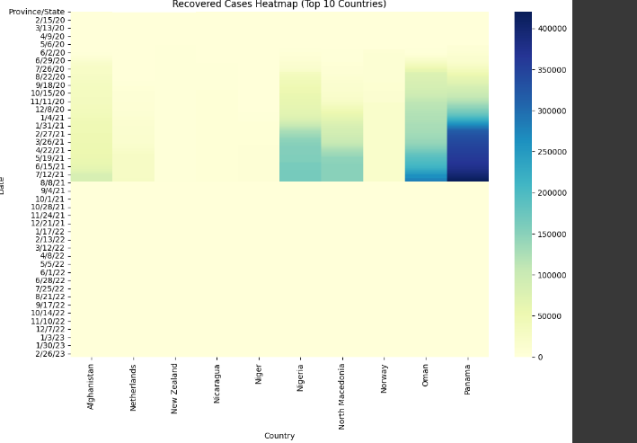
DATA VISUALIZATION WITH COVID DATASET
CHAPTER-3
RESULTS
heatmap, a type of data visualization that uses color to represent the magnitude of data values in a matrix. Let's break down the components and what they signify:
Rows (Y-axis):
Each row corresponds to a date, as seen on the left side of the heatmap. The format appears to be YYYY-MM-DD, indicating the specific days.
Columns (X-axis):
Each column represents a different category or variable, labeled at the bottom of the heatmap. These categories might be specific metrics, activities, or other data points being tracked over time.
Color Gradient:
The colors range from light yellow to dark blue. This gradient represents the magnitude of the values, where lighter colors indicate lower values and darker colors (moving towards blue) indicate higher values.
Color Bar (Legend):
On the right side of the heatmap, there is a color bar that serves as a legend. It shows the scale of the values, indicating how the colors map to specific data values. The lowest value is near the light yellow, and the highest value is near the dark blue.
Interpreting the Heatmap
Date-Based Analysis:
12
School of Computer Science Engineering & Information Science, Presidency University.

Slide 17
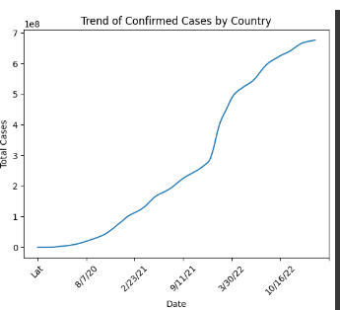
DATA VISUALIZATION WITH COVID DATASET
CHAPTER-3
RESULTS
A line graph, also called a line chart or line plot, is a visual representation of data that changes over time. It uses a series of connected data points plotted on two axes:
Horizontal axis (X-axis): This axis typically represents time (days, weeks, months, years) but can also represent any other continuous variable.
Vertical axis (Y-axis): This axis represents the values you're measuring, often numerical values.
Each data point on the graph is marked with a small symbol (circle, square, etc.) and connected to neighboring points by a line segment. This line helps visualize the trend or change in the data over time.
Here are some key features of line graphs:
Trends: The slope of the line indicates the direction of the trend (increasing, decreasing, or flat). A steeper slope signifies a more rapid change.
Patterns: Line graphs can reveal recurring patterns or cycles in the data.
Comparison: You can use multiple lines on the same graph to compare trends between different variables.
Highlighting outliers: Points that deviate significantly from the overall trend might be outliers and warrant further investigation.
Line graphs are useful for various applications, including:
Tracking growth: Visualizing trends in sales figures, website traffic, or stock prices.
Monitoring changes: Observing fluctuations in temperature, air quality, or disease cases over time.
12
School of Computer Science Engineering & Information Science, Presidency University.

Slide 18
DATA VISUALIZATION WITH COVID DATASET
CHAPTER-4 CONCLUSION
In conclusion, our analysis provides valuable insights into the COVID-19 pandemic, shedding light on its global impact, spatial distribution, temporal dynamics, and key epidemiological trends. Through a systematic methodology encompassing data collection, preprocessing, analysis, and visualization, we have synthesized complex data into accessible and actionable insights, contributing to a deeper understanding of the pandemic and its implications.
Our findings highlight several key observations:
Global Impact: The COVID-19 pandemic has had a profound impact on a global scale, with millions of confirmed cases and significant loss of life. The pandemic has strained healthcare systems, disrupted economies, and altered social norms, underscoring the need for coordinated and evidence-based response efforts.
Spatial Distribution: Geospatial analysis reveals spatial disparities in the distribution of COVID-19 cases and fatalities, with certain regions experiencing higher burdens of disease than others. Hotspots and clusters of transmission can be identified, informing targeted interventions and resource allocation strategies.
Temporal Dynamics: Time-series analysis elucidates the temporal evolution of COVID-19 cases and deaths over time, highlighting trends, fluctuations, and seasonality in the data. Dynamic visualizations such as bar chart races provide a compelling narrative of the pandemic's trajectory, illustrating the effectiveness of containment measures and the emergence of new challenges.
13
School of Computer Science Engineering & Information Science, Presidency University.

Slide 19
DATA VISUALIZATION WITH COVID DATASET
4. Epidemiological Trends: Comparative analysis of key epidemiological metrics, including mortality rate, infection rate, and case fatality rate, offers insights into the severity and transmissibility of the virus across different contexts. Understanding these trends is crucial for assessing the effectiveness of public health interventions and guiding future response efforts.
In light of these observations, it is evident that the COVID-19 pandemic represents a complex and multifaceted challenge requiring a coordinated and multifaceted response. While significant progress has been made in understanding the virus and developing vaccines and treatments, the battle against COVID-19 is far from over. Continued vigilance, collaboration, and innovation are essential to overcoming the pandemic and building resilience against future threats.
Moving forward, our analysis underscores the importance of data-driven decision-making and evidence-based policies in combating the pandemic. By leveraging the power of data visualization and analysis, we can better understand the dynamics of the pandemic, identify effective strategies for containment and mitigation, and ultimately safeguard public health and well-being.
As we navigate the uncertain road ahead, let us remain steadfast in our commitment to solidarity, compassion, and resilience. Together, we can overcome the challenges posed by COVID-19 and emerge stronger and more united than ever before.
In closing, we extend our gratitude to all frontline workers, healthcare professionals, researchers, and individuals who have tirelessly worked to combat the pandemic and support those affected by it. Your dedication and sacrifice inspire hope and resilience in the face of adversity.
14
School of Computer Science Engineering & Information Science, Presidency University.

